Slide 1
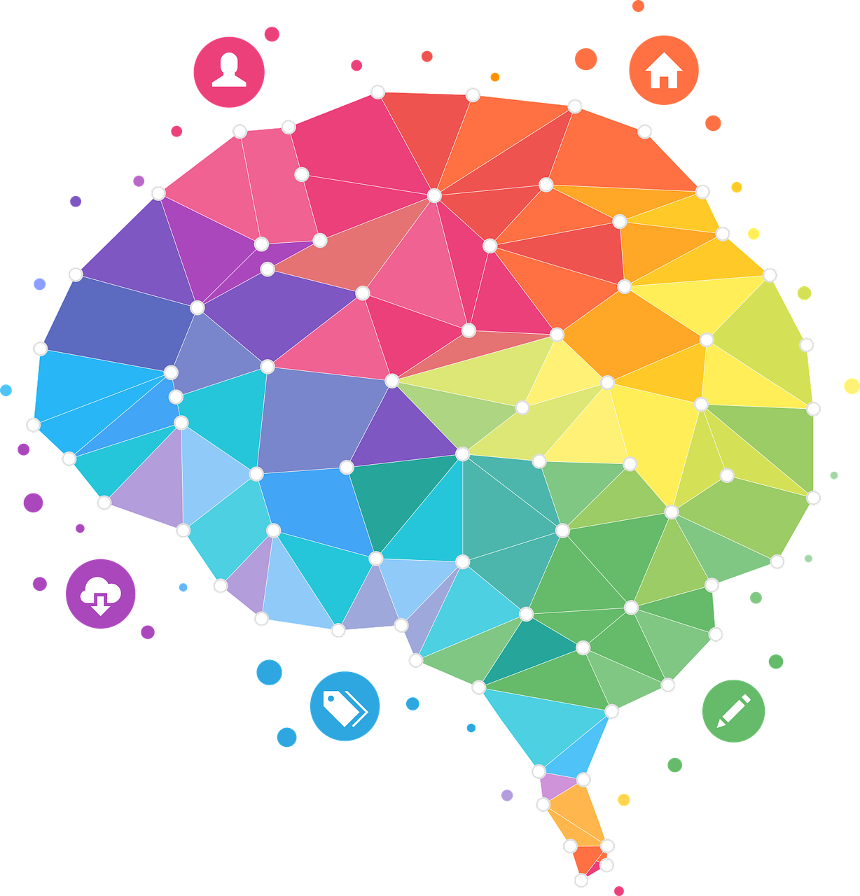
NEURO-INCLUSIVITY: THE FUTURE OF THE TECH INDUSTRY

Slide 2
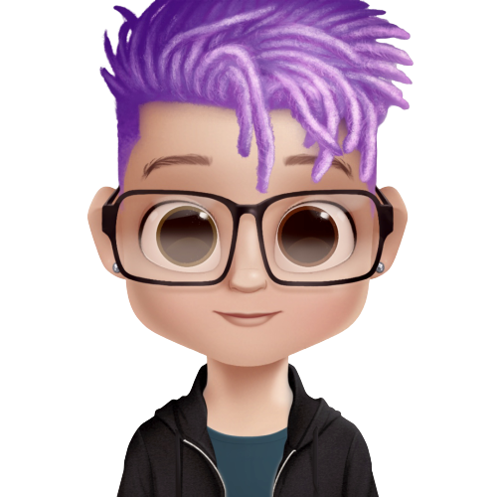
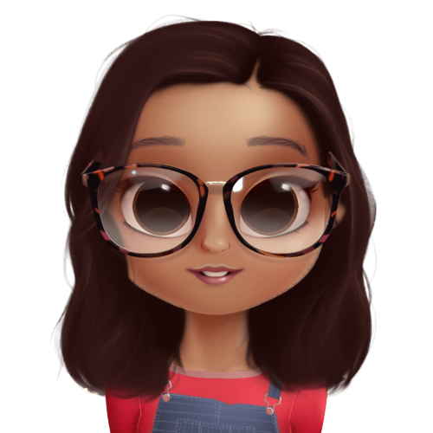
Hi!
I’m Rin Oliver
Freelance Technology Journalist at Armory.io and Fixate.io
You can find me on Twitter at @kiran_oliver
I am Leena Haque
Senior User Experience Designer @BBC
You can find me on Twitter at @L1LHulk
Notes:
Rin & Leena introduce themselves.
Leena: Icebreaker ☺ - We are diversity unicorns making history – quite possible the first ever Jewish/Muslim/LGBTQ/Nonbinary/American/Asian/Neurodivergent speaker duo!

Slide 3
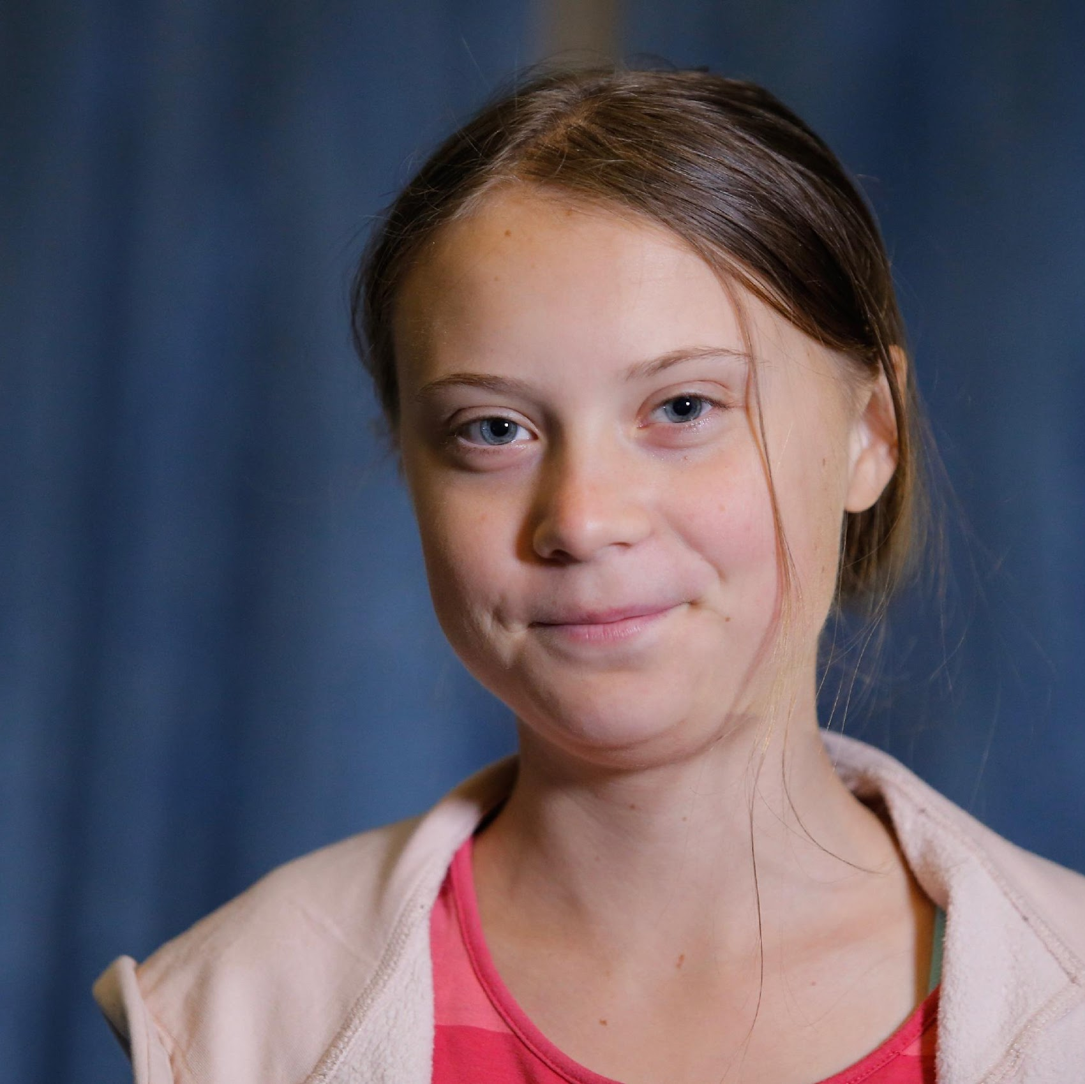
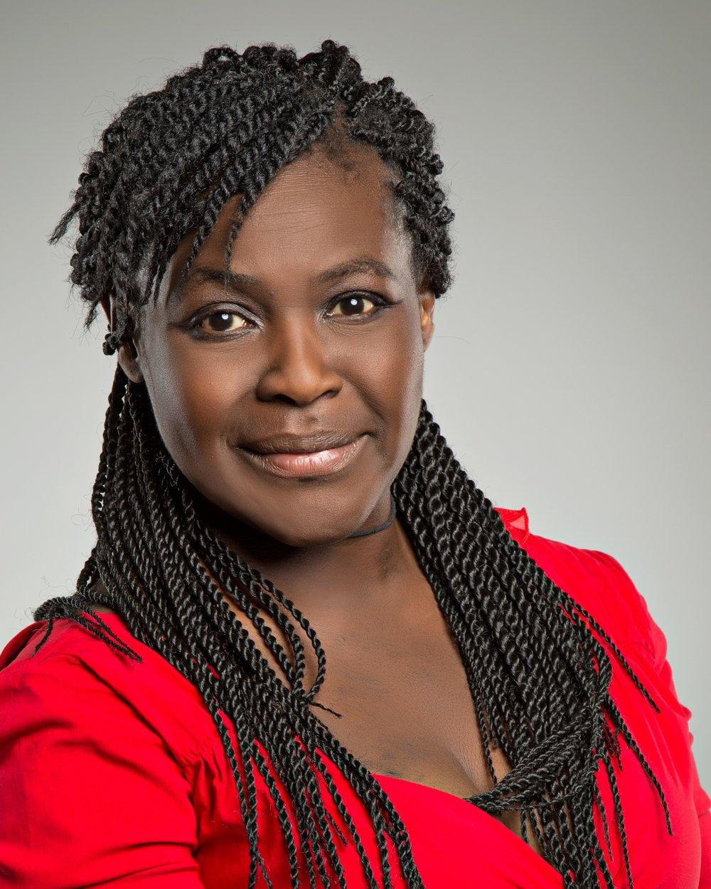
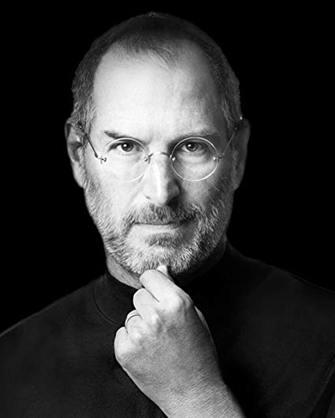
What is Neurodiversity?
Definition
Natural variation in human cognitive function
Autism, dyslexia, dyspraxia, Tourette's syndrome, etc..
Recognising the scientifically proven value of different thinking styles.
Innovators
Creatives
Technologists
Scientists
Thought Leaders
Out of the box Thinkers
Genre defining
Notes:
Rin : Neurodiversity describes the natural variation in human cognitive function, recognising the value in distribution of skills profiles from different thinking styles. This umbrella term includes autism, attention deficit hyperactivity disorder (ADHD), dyslexia, dyspraxia, Tourette's syndrome, etc..
For a long time there was much misinformation about ND conditions, but gradually people began to understand that in fact this was a community that included many of the most infamous names to have defined modern society. For example, Greta Thunberg has Asperger’s. Albert Einstein (was autistic + dyslexic), Steve Jobs (was Dyslexic) and father of computing/AI Alan Turing was autistic - and would any of these icons who changed the world make it through today’s recruitment process?? Unlikely.

Slide 4

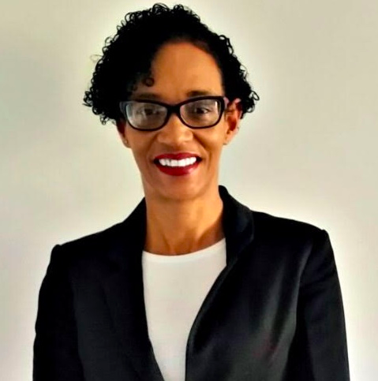
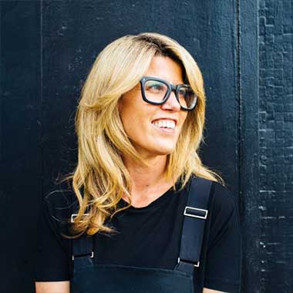
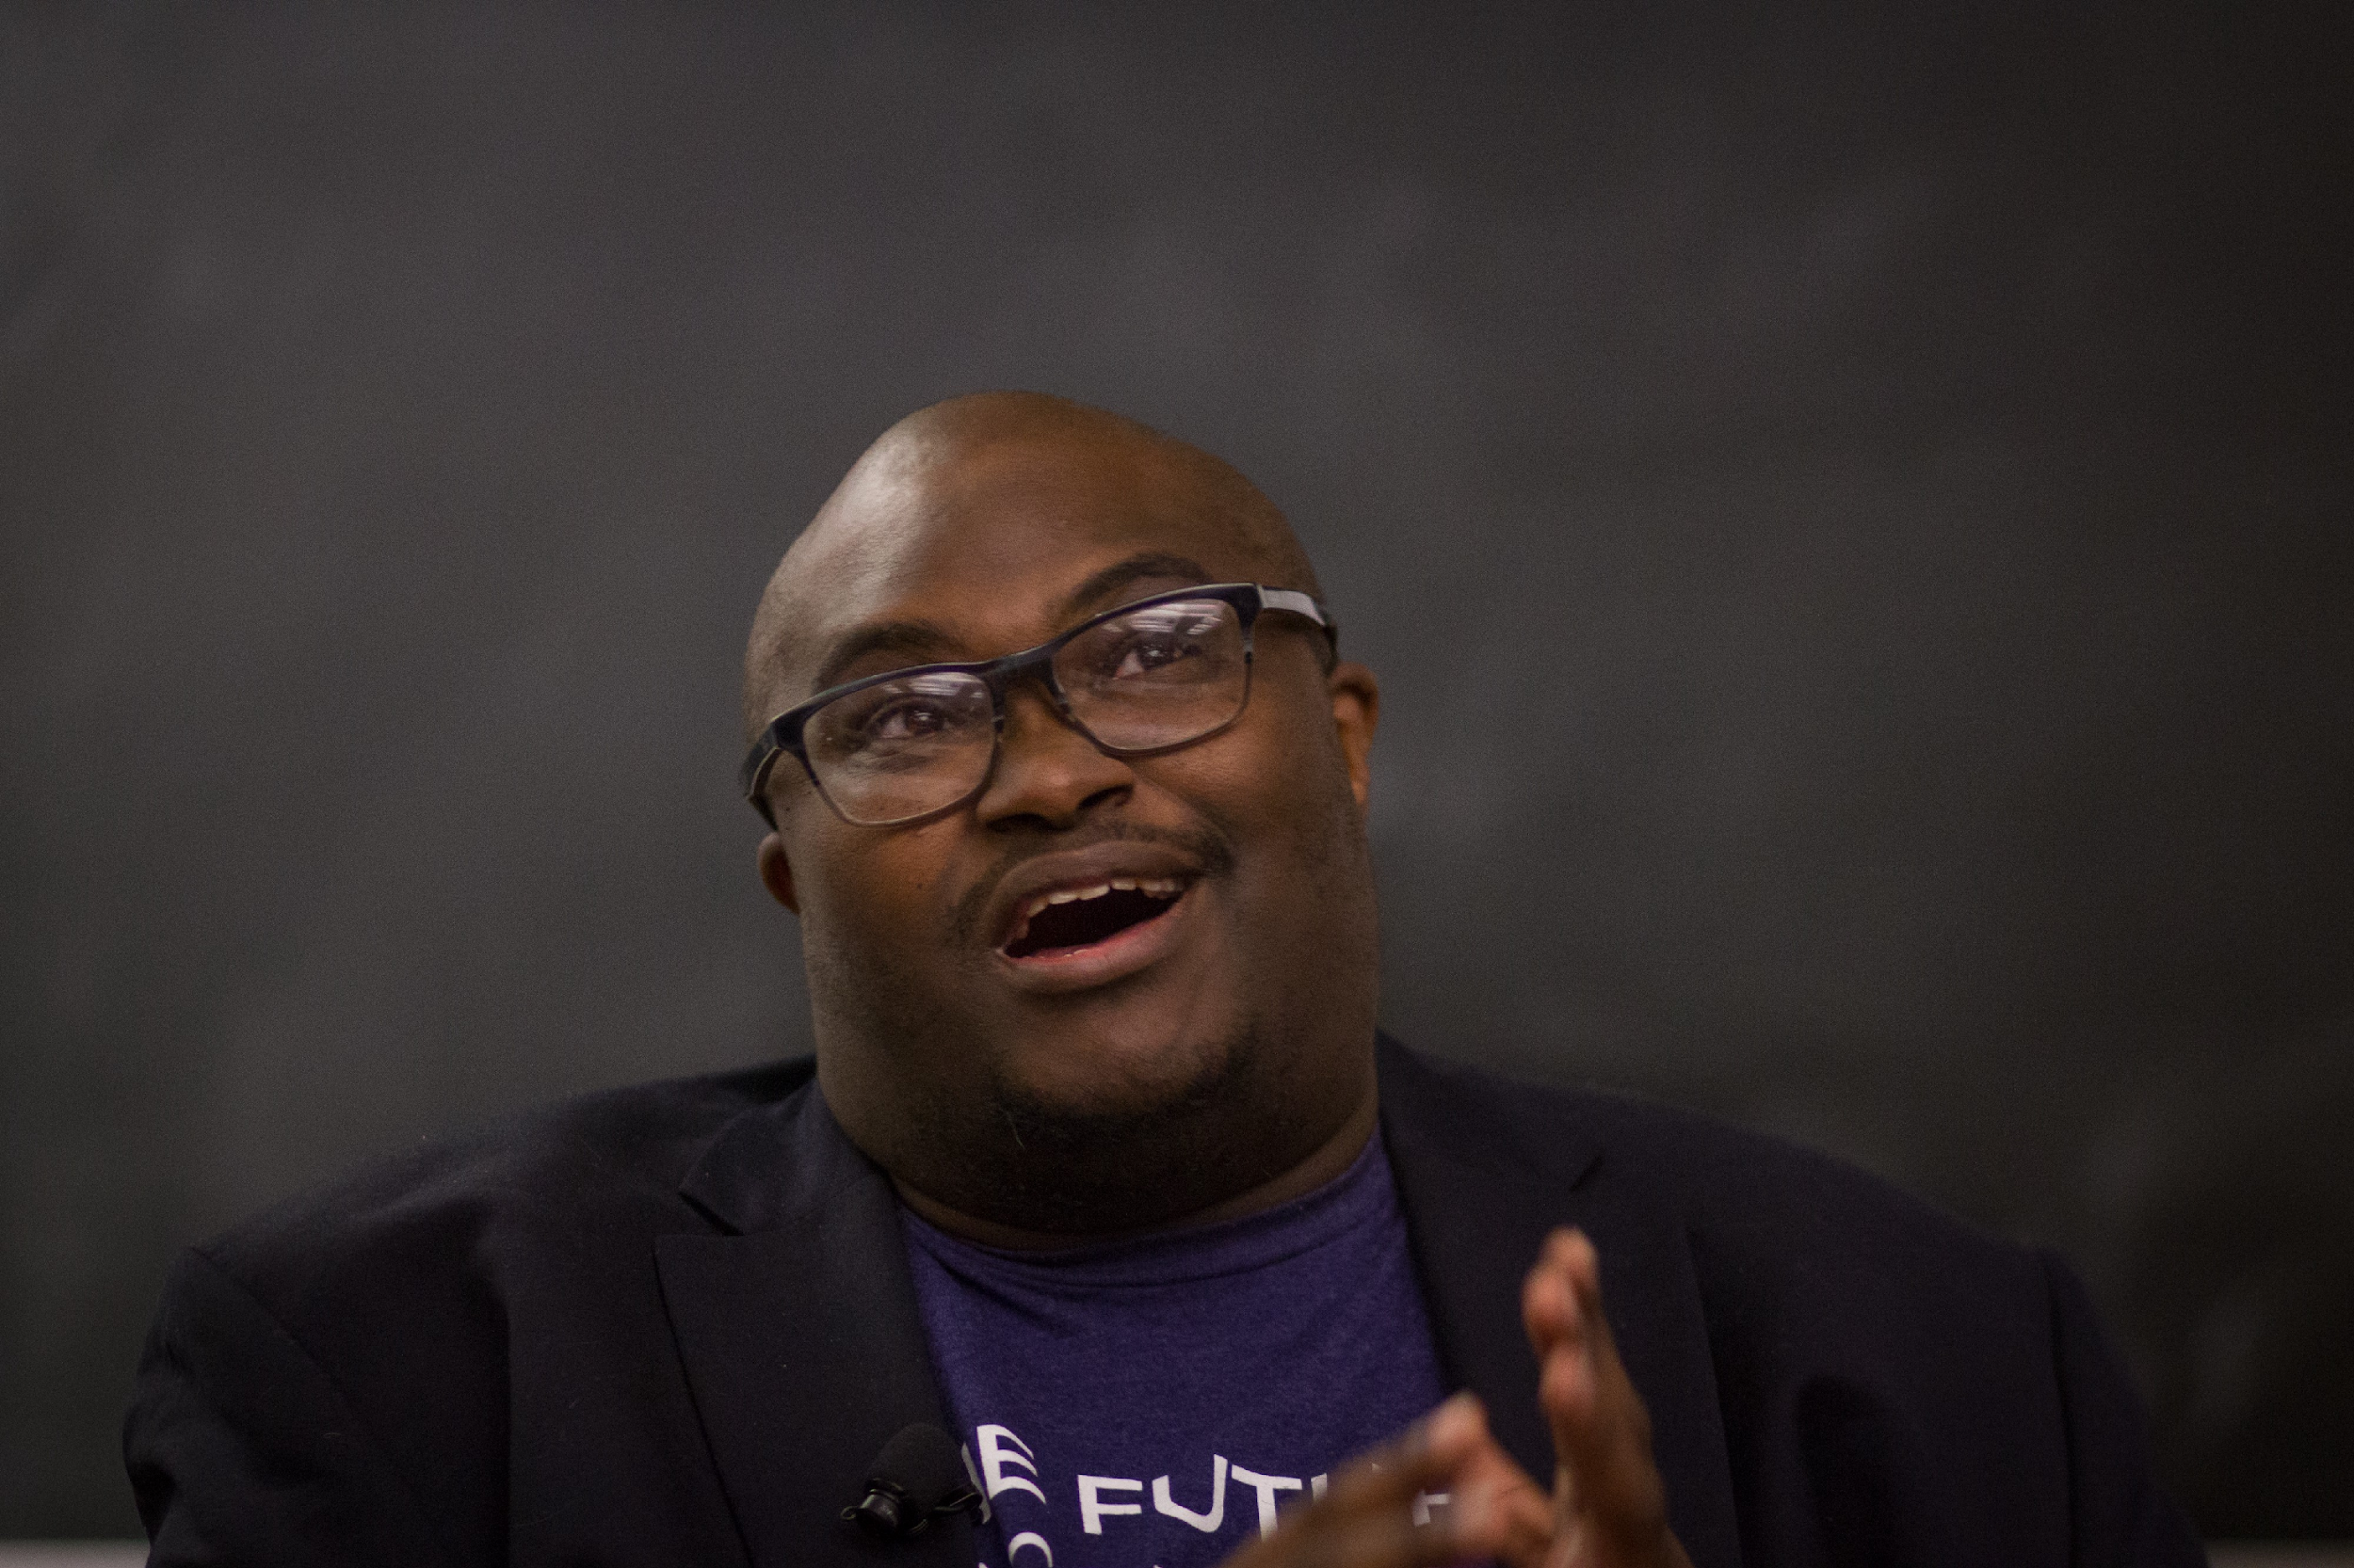
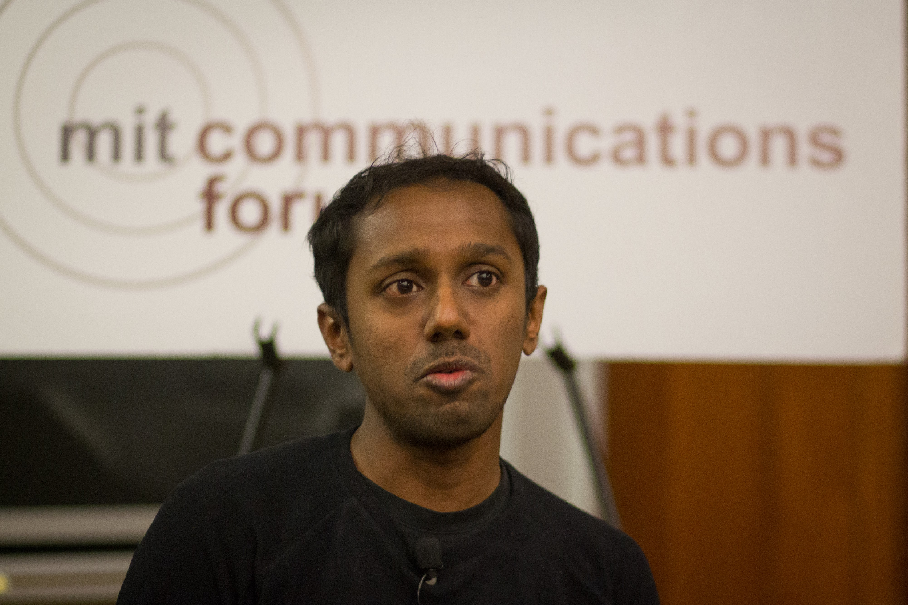
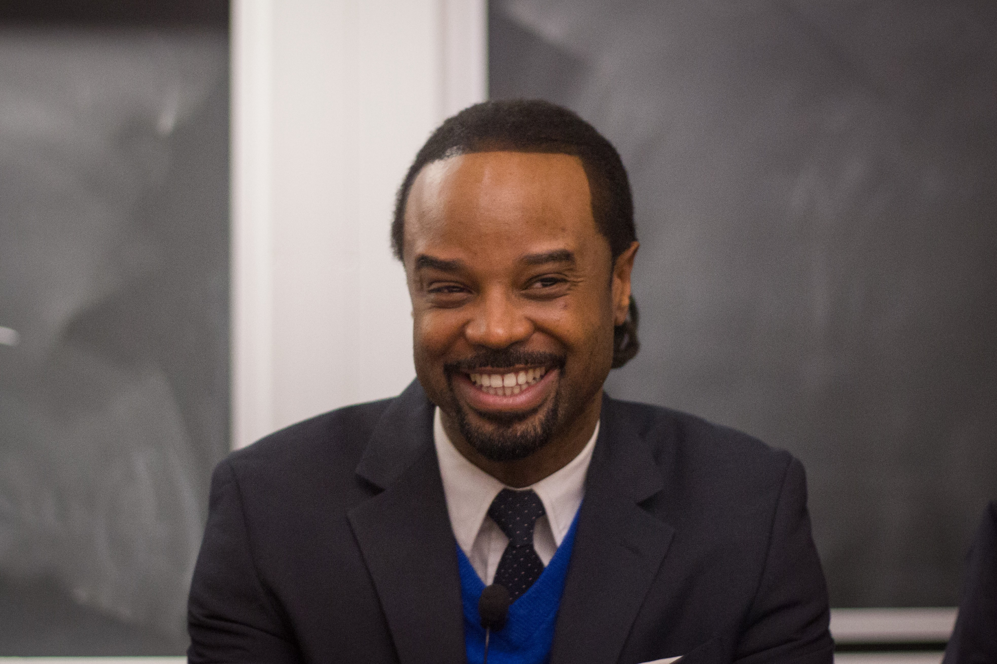
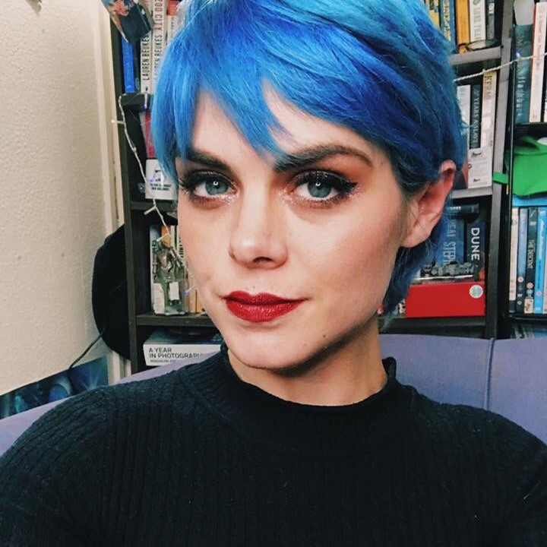
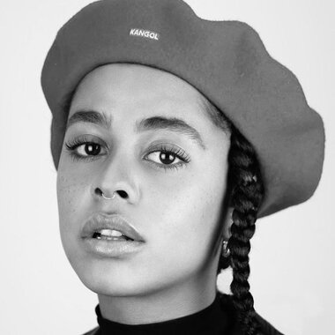
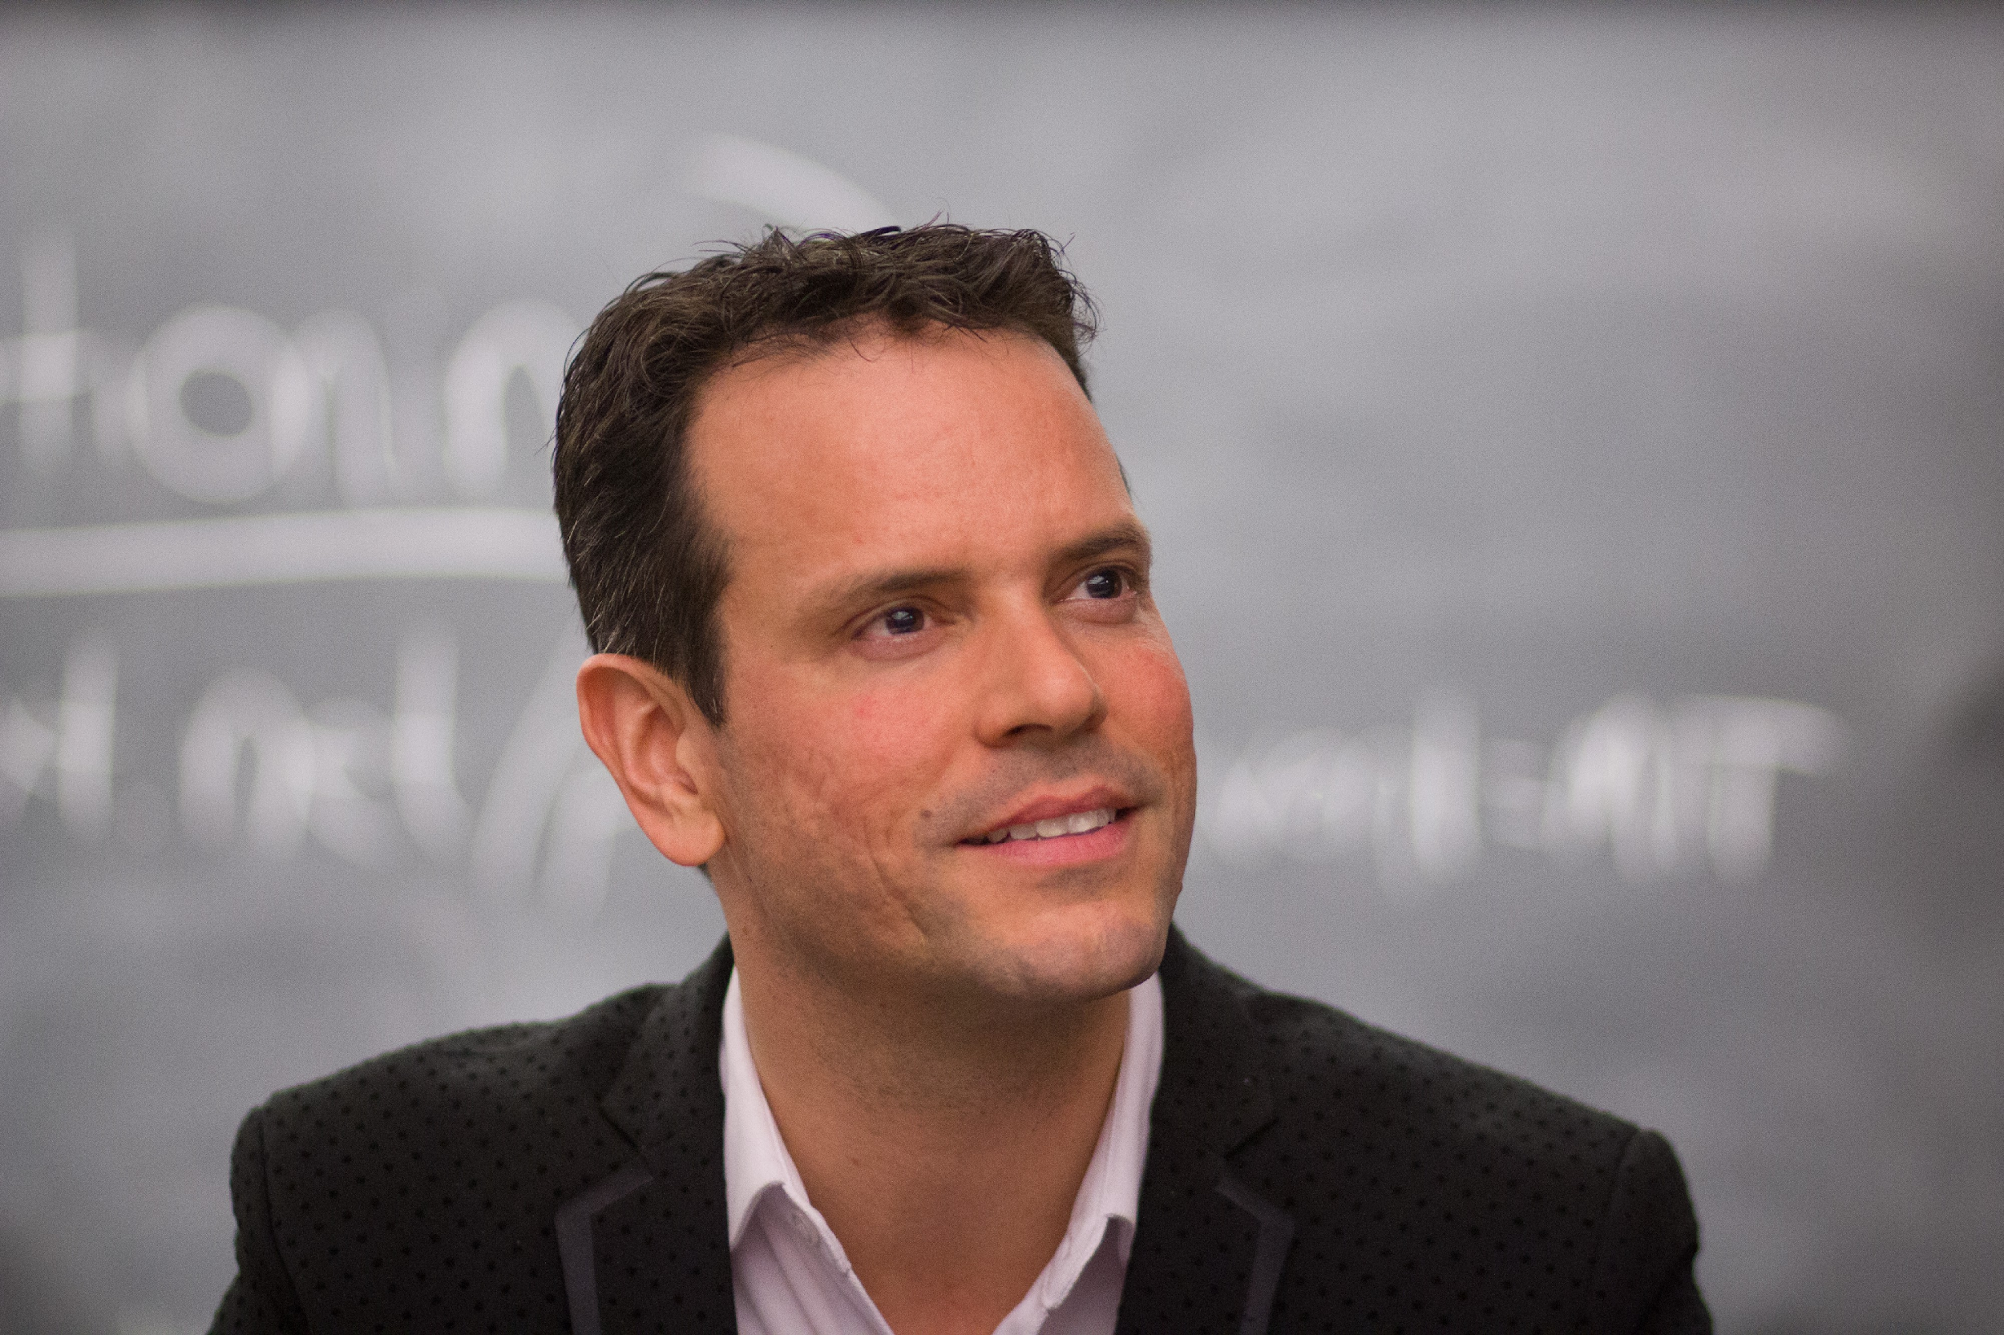
The Potential of Neurodiversity
20-30% of the population
Typically under 35
Don’t all identify as disabled just differently wired
Future Focused Skillsets:
Creativity
Strategic thinking
Complex Problem solving
Critical thinking
Out-of-the-box thinking
Notes:
Leena:
Statistics: Around 20-30% of the world population/ it is estimated that around 1 in 7 people (more than 15% of people in the UK) (Reference: https://archive.acas.org.uk/neurodiversity)
Miseducation and unemployment of neurodivergent individuals also has a negative impact on companies, whether they realize it or not. Those who are considered neurodivergent possess unique skills that others may lack, such as strong creative, analytical skills, pattern recognition, critical thinking and information processing.
These are all skills that are in high demand when it comes to careers in robotics, process automation, artificial intelligence and other areas of science, technology, engineering and math (STEM). Many companies struggle to find qualified candidates for these positions because they continue to look in the depleted pool of conventional candidates and are overlooking those who think differently, even though they may be a perfect fit.

Slide 5
Attracting & Hiring Neurodivergent (ND) Talent
Companies should endeavor to make their hiring and interviewing process accessible and welcoming to those that are neurodivergent.
When hiring neurodivergent talent, understand that the traditional interviewing process may be significantly more challenging.
Retaining neurodivergent talent is something that many companies struggle with.
While many of today’s open source organizations are constructing neurodivergent hiring initiatives, please do have procedures and processes in place that will ensure smooth and successful onboarding and long term retention of your neurodivergent talent.
These can include: The ability to work from home, flexible working hours, limiting required in-person or virtual meeting attendance, an accommodating sensory office environment, and understanding that while some neurodivergent people may come across as ‘anti-social’ this is often not true.
Notes:
Rin: This can be due to difficulties understanding and using nonverbal social cues in a manner that is understood as ‘acceptable social code’ by those that are neurotypical, auditory processing difficulties, anxiety talking on the phone or on Zoom, etcetera.
Many of us enjoy time with coworkers and friends, we just need to be allowed flexibility in how and when we interact with others, both in the office and outside of it at team building events, conferences, and other situations.

Slide 6
Recruiting and Interviewing Neurodivergent (ND) Talent
Ask yourself: Are your job descriptions, tasks, and daily work/life balance welcoming to those that are neurodivergent?
Make sure that recruiters and interviewing/hiring managers are aware of what neurodiversity is, and what challenges are present for neurodivergent job candidates when interviewing.
Interviewing for ‘culture fit’ is a biased hiring practice that allows companies to continue only hiring neurotypical talent that answers questions how the company expects them answered [usually to fit a neurotypical thought process], rather than allowing for neurodivergent talent to answer questions how they see fit.
Many neurodivergent individuals are made extremely uncomfortable by traditional SMART-style or overly personal interview questions. If possible, avoid these and get to know us as individuals.
Notes:
Rin: Whenever possible: Do not require off-site team building or mandatory in-person meetings, and ensure that job descriptions allow for flexibility in where, when, and how one works during the day. Strive to ensure that the application and interview process are welcoming to those that are neurodivergent.

Slide 7
Organisational procedures and the barriers they present to ND talent
Having accessible company policies and procedures that are welcoming to those that are neurodivergent.
If your company operates entirely within a 25-page online only handbook they expect people to read to understand how to do their job, this is inaccessible to neurodivergent talent.
When you send instructions to people, consider how they prefer to digest information. Lengthy emails can be difficult to parse. Consider having audio, video, and other documentation versions available, rather than having key information only available via reading.
Make important information available in a variety of formats. This can include video, audio, GitHub/GitLab issues, Google Docs, transcripts, on the web, and via EMail/Slack.
Notes:
Rin: Make sure your company policies and procedures are welcoming to those that are neurodivergent.

Slide 8






Organisations with Neurodiversity specific programs
Notes:
Leena:
In the last decade, large companies, particularly tech companies realized that they had neurodiverse talent on their staff. Many of these employees have demonstrated special skills in pattern recognition, memory, or mathematics on teams working to solve highly complex problems.
Neurodiversity is gradually being recognised as an opportunity and also competitive advantage. A small but growing number of companies such as Microsoft, SAP, and IBM for example have hiring programs designed explicitly around neurodiversity. They are making changes in hiring, retention, and management practices to make more opportunities available.
Unfortunately the majority of employers - seven in 10 employers to be precise do not include neurodiversity in their people management practices (reference: https://www.personneltoday.com/hr/neurodiversity-ignored-seven-10-employers/)
More needs to be done. Employers ready to make changes to their hiring processes are already reaping the substantial rewards that come from bringing neurodiverse talent into their teams.

Slide 9
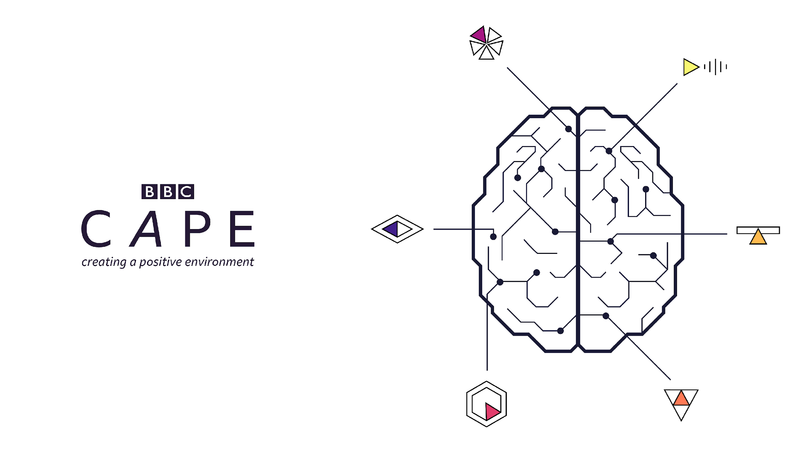
Workspace & Culture
Creating a Positive Environment – A creative initiative exploring attitudes toward Neurodiversity in the workplace.
Promote Understanding
Provide Training
Positive Action for Success
Twitter: @BBCCape
Notes:
Leena:
BBC Neurodiversity program – CAPE Creating A Positive Environment
BBC Statement of Intent
Creating an environment that empowers you to bring your authentic self to work is a priority at BBC

Slide 10
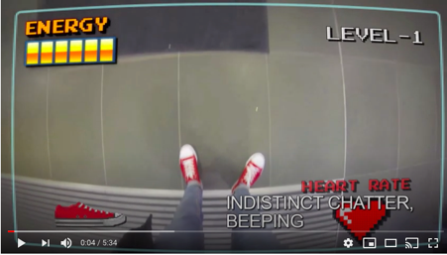
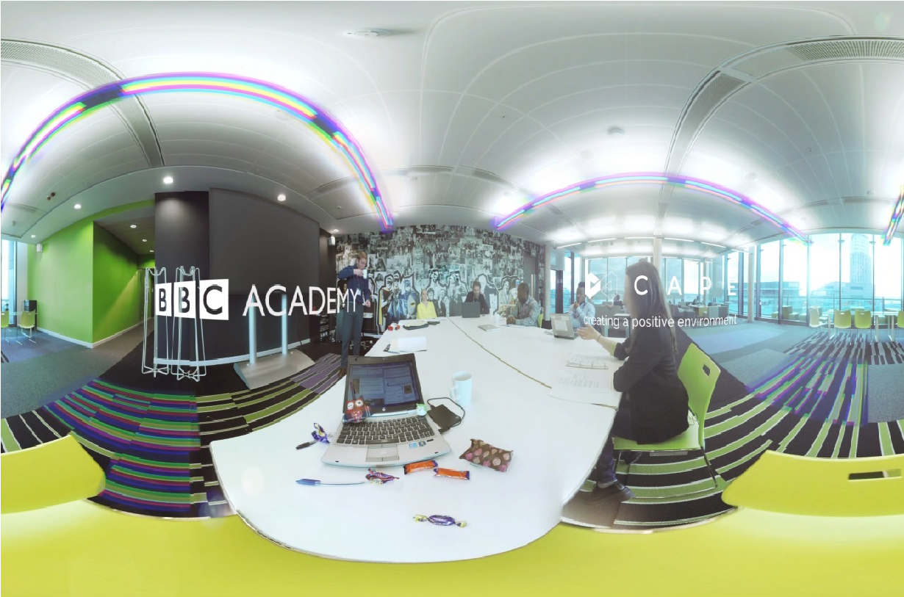
Neurodiversity Awareness Training
ND MODE: IN MY SHOES
ND DAZE 360 VIRTUAL REALITY EXPERIENCE
Notes:
Leena:
Historically, due to the lack of understanding from management, neurodiverse talent often had issues adjusting to the corporate work culture. Neurodiversity awareness training in the workplace is a highly beneficial way to bridge the gap between the professional workforce and neurodivergent individuals.
Neurodiversity training programs help organizations attract, hire and retain talent that thinks differently. This training is highly beneficial because it educates employees and management about neurodiversity at work and how to create a more accepting, inclusive work environment so all members of the company can thrive.
With regards to training on Neurodiversity awareness, here are examples of training films we produced at the BBC including a 360 degree virtual reality immersive experience and various training workshops on Neurodiversity awareness. The films can be found on YouTube
ND Mode (YouTube) – 1st Person film - https://youtu.be/2Mez9THUoyc This film takes the perspective of someone who is neurodivergent and allows the viewer to experience the physical and sensory challenges they would face in a typical day at work. The film employs an innovative gaming style to engage its audience in a creative way and increase awareness of these often misunderstood and misrepresented conditions.
ND Daze (YouTube) – 360VR experience - https://youtu.be/ZLyGuVTH8sA

Slide 11
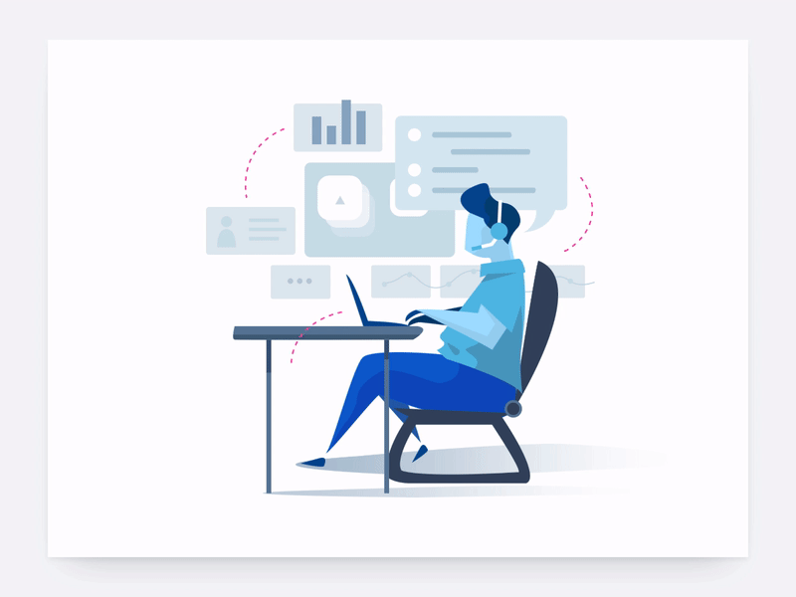
Workplace Adjustments
Notes:
Leena:
There are many adjustments an organisation can make with minimal or no financial cost. Some examples of these adjustment are;
Explore Flexible working arrangements, such as start & finish times or remote working to help avoid rush-hour for example, for people who are overwhelmed by noise and crowds;
Environmental flexibility – Consider how to adapt the office to better suit working preferences, quiet spaces when needing to concentrate on an important report for example, to overcome the drawbacks of open-plan offices and also offer options to work from home.
Feedback flexibility, or spending additional time on instructions and understanding communication preferences. This may seem unreasonable as it requires some extra time – but consider, would you consider it reasonable to spend additional time figuring out access into a building for an individual in a wheelchair? It is basically the same situation, we just don’t appreciate all accessibility needs.
Training flexibility – giving out handouts in advance, letting people know the structure of the training day in advance, ensuring there are plenty of breaks.
Provide assistive technology (such as speech-to-text or vice versa);
When team culture demonstrates psychological safety, the team members can bring their authentic selves to the workplace and flourish. Environment plays a big part in this as well as culture – the working environment can make a huge difference to someone’s ability to succeed.

Slide 12
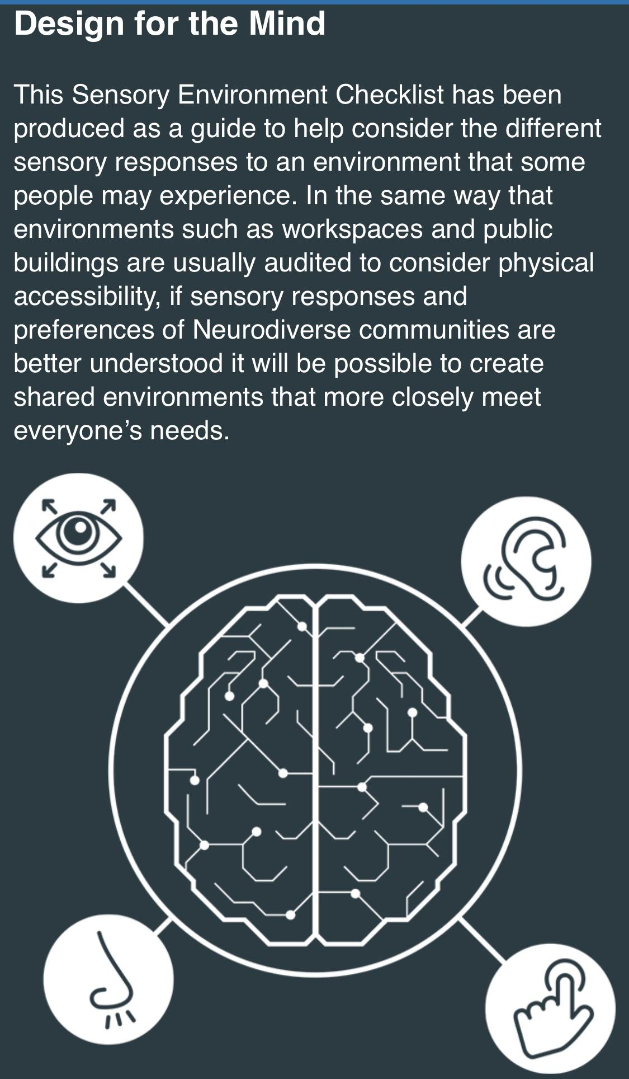
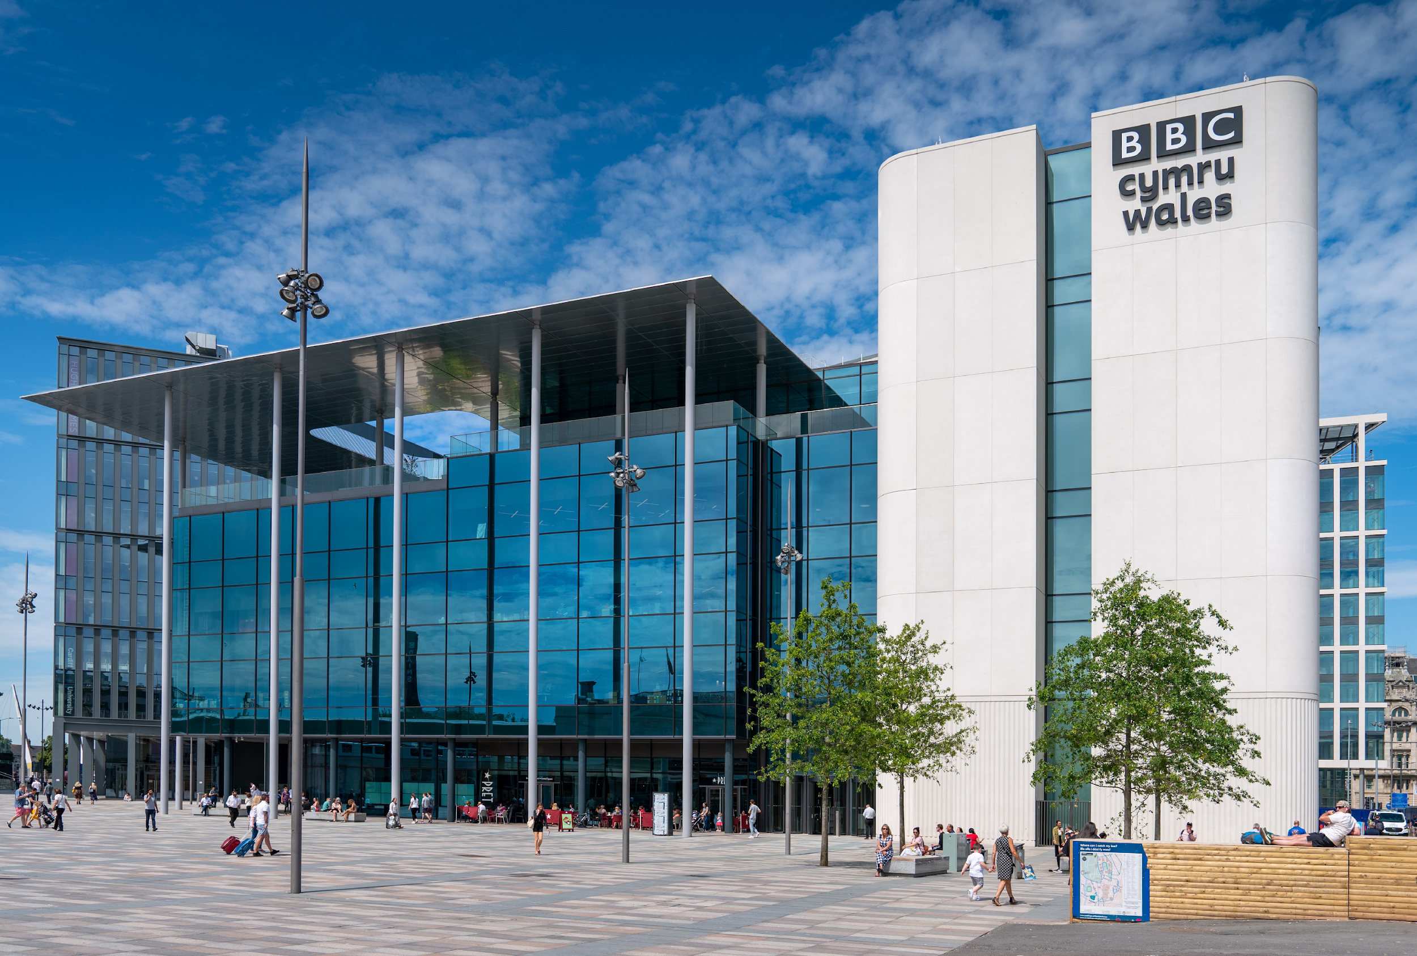
Design Neuro-Inclusive spaces
BBC Cardiff HQ Building - designed with neurodiversity in mind
BBC CAPE Sensory Design Checklist:
https://bbc.github.io/uxd-cognitive/
Notes:
Leena:
As part of the BBC's mission to help create neuro-inclusive workspaces, we’re pleased to share our design checklist which considers different #sensory responses to an environment experienced by many people especially #neurodivergent individuals. In the same way that workspaces are usually audited to consider physical accessibility, this toolkit will help inform adjustments required to support Neurodiverse communities, moving toward creating Universal Environments – those that meet everyone’s needs. https://lnkd.in/duUA7FS
The BBC’s Cardiff HQ building considers neurodiversity in the working environment by creating an inclusive workplace. We are taking this seriously and we now have a new building that included cognitive accessibility in its design brief is not just a world first, but a huge step toward building for the workforce of the future…
In this building design project we thought about how people with neurodivergent conditions experience space – with different perceptions, memory processes and judgements of time and distance. This set a trajectory for the project that was based on understanding physical and neurological diverse needs of individuals – many of which had not been fully addressed before.
Creating spaces that are sensitive to neurodiversity does not mean compromising on design quality or adding a cost premium to the project. We wanted to create energetic, colourful and collaborative spaces that were nevertheless sensitive to neurodiversity.
BBC CAPE’s sensory toolkit helped examine many different elements of the design, including: how landmarks, colour and texture can assist way-finding; using the right colours and contrasts in the manifestations, fabrics and flooring; and training the reception staff to help all people use the building.
Perhaps one of the simplest and most impactful changes we made was with lighting. Flickering lights are commonplace in office environments and can be a major hindrance. Non-flickering LED lamps and a drop in lighting levels evoke a more comfortable and domestic feel.
These elements are complemented by a thoughtful range of spaces that recognise open-plan environments cannot work for everyone all of the time (hot desking is not ideal for a lot of ND people). In the new Cardiff building, you can find quiet and calm spaces throughout the floor levels - used for focused work, allowing people to get away from the noise and hubbub and select the work settings best for them.
The specific design features promote a level of inclusivity as we found that by considering neurodiversity in design we catered for everyone. This intrinsic approach does not only create a fairer environment but also allows an organisation to maximise the potential of two key investments – people and property. As we think about redesigning office spaces to adjust to the impact of Covid19 we can use the opportunity to create more inclusive spaces.
With wellbeing in the workplace now higher on the agenda, as well as a growing acknowledgement that one-size-does-not-fit-all in a productive office, it’s up to us to continue to keep thinking about what makes a building inclusive.

Slide 13
"One way to understand neurodiversity is to think in terms of human operating systems - just because a PC is not running Windows doesn't mean it's broken."
Steve Silberman
Notes:
Leena:
Neurodivergent people are assets not problems.
We have to realise our future is in harnessing our creativity, our diversity of thought, our ability to consider the impossible – our creativity, imagination, dreams
Conventional doesn’t work anymore. It’s not just about change, we need to evolve our expectations– rewire our conventional thinking.
But, if we embrace this new way of thinking, our neurodiversity, it will help us refocus on those skills that make us human.

Slide 14
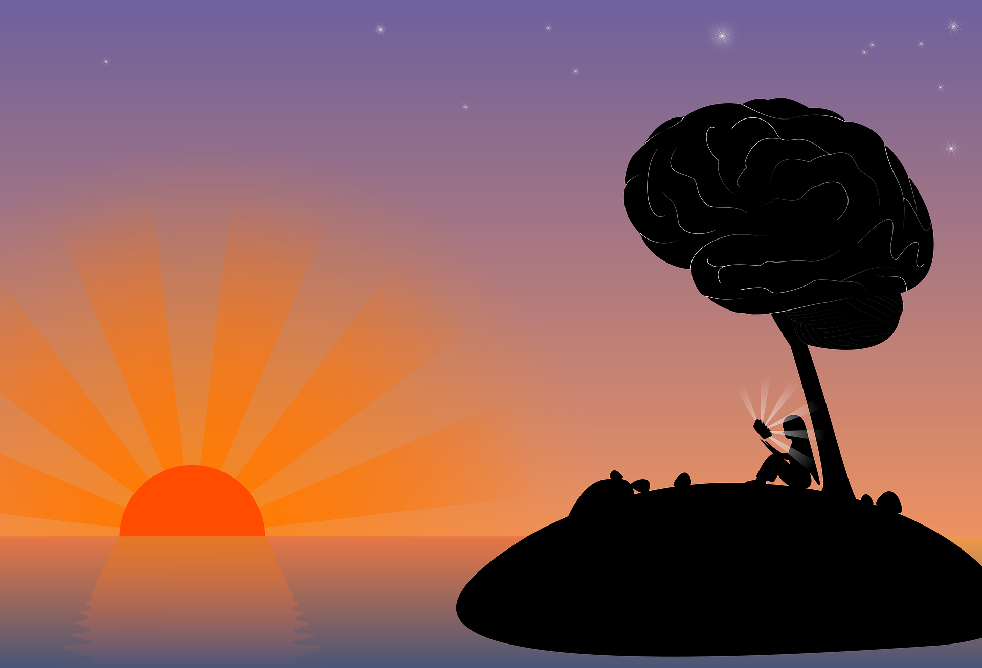
Täkiwatanga "in his/her/their own time and space"
Notes:
Rin:
Maori word for #autism is #TAKIWATANGA which means "in his/her/their own time and space”, coined by Keri Opai for Māori language use in the Mental Health, Addiction and Disability sectors, for a project called ‘Te Reo Hāpai – The Language of Enrichment.’, learn more by visiting https://www.altogetherautism.org.nz/
Rin spent four years living in New Zealand and is a permanent NZ resident married to a Kiwi citizen, so seeing this is great for them

Slide 15

Address the stigma…change the culture
Autistic people are individuals. We are not all maths geniuses, we don’t all like trains. I am hopeless with technology and much prefer painting. There is no ‘typical Autistic.’ But I think we probably all like being respected and validated. – Jeanette Purkis
Notes:
Leena & Rin – final thoughts
What can you do?
Training – Educate staff by learning from your neurodivergent colleagues
Dispel the myths and stigmas. Avoid misunderstandings, remove the unconscious bias.
Become more accepting of different communication and thinking styles
Re-engage with the human skills of management – empathy (EQ) and Communication/active listening
360 mentoring - Line managers & team leaders benefit from this
Get to know your ND colleagues in an environment they feel safe and comfortable in – think about the design of the environment – is it ND-friendly.
Be open to change
Be mindful of Neurodiversity in the recruitment process. Reduce focus on “cultural fit” and social aptitude tests.
Be flexible and make adjustments
Explain how people will be supported
Think about your wider impact – 1 in 7 users/customers are ND too.
Ensure technology, content and products are accessible for people who are ND
Talk to us - we’re happy to help/advise :)

Slide 16
THANKS!
Any questions?
You can find us at:
@L1LHulk · Leena.Haque02@bbc.co.uk
@kiran_oliver · ck@ckoliver.com

